Slide 1


WELCOME NEW MEMBERS!
Purpose: Understand your rights, responsibilities,
and union support
August 20, 2025

Slide 2

WHAT IS CUPE LOCAL 1015
CUPE = Canadian Union of Public Employees
Mission: Protect rights, promote fairness, improve work conditions
CUPE 1015 Represents workers:
- City of Lloydminster,
- Public Library,
- Pioneer Complex
2

Slide 3


WHAT WE DO
- Negotiate Collective Agreements that secure your rights and benefits
- Support Members through grievances, workplace issues, and advocacy
- Promote Health & Safety and uphold your legal protections at work
- Educate and Empower through training and leadership opportunities
- Build Solidarity through campaigns, community engagement, and union events
3

Slide 4
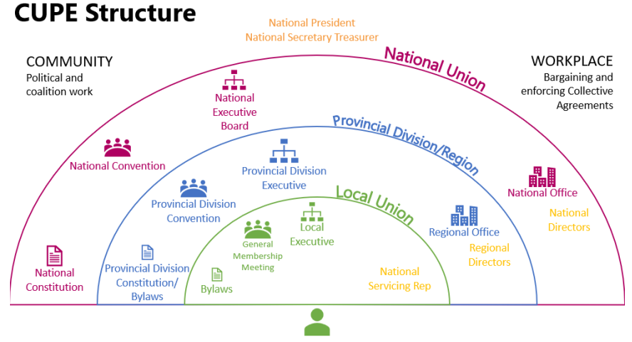
4

Slide 5
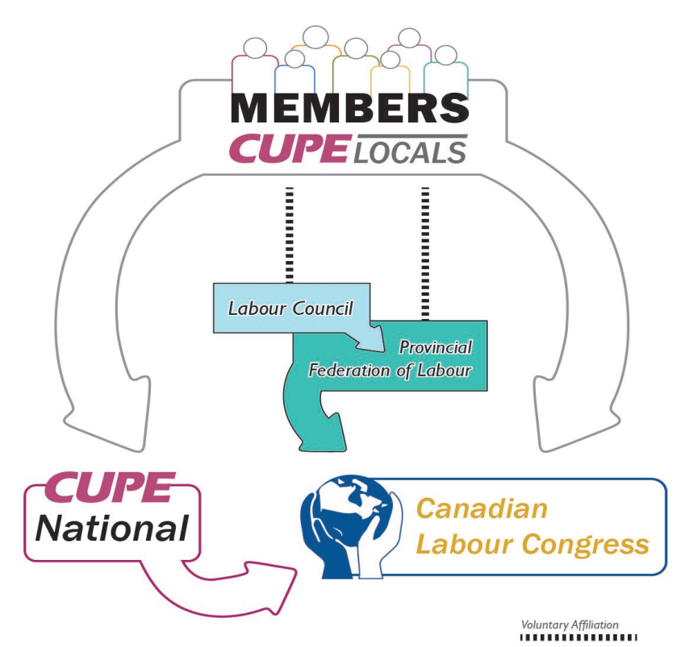
Canada’s Labour Movement
5

Slide 6


Positions of the CUPE 1015
- President,
- Vice-Presidents: Civic, Public Library, Pioneer Complex
- Secretary-Treasurer
- Recording Secretary
- Trustees
- Stewards
- Committees (Social Events, Bargaining, Bylaw, etc.)
Names and Contacts can be found:
CUPE 1015 https://1015.cupe.ca/
2. OneCity Connect: My Employment/Cupe1015
6

Slide 7

Labour-Management Relations
•Joint meetings to resolve workplace issues
•Union brings your concerns to the table
•Help shape discussion with your feedback
7

Slide 8

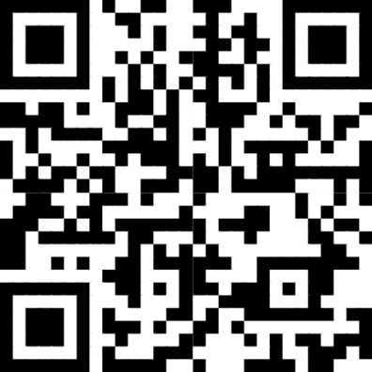
Collective Agreement
•A legally binding contract between union and employer
•Includes: wages, benefits, hours of work, overtime, leave, etc.
Union Dues
•1.5% of your wages
•Used for legal support, education, admin, strike fund
•Support solidarity actions
Training & Support
•CUPE workshops on safety, equity, mental health
•Resources: CUPE.ca, alberta.cupe.ca
8

Slide 9
Your Rights as a Union Member
Your Responsibilities
•Representation, grievance filing, safe workplace
•Attend union meetings, participate in decisions
•Protection from discrimination and harassment
•Follow workplace rules and procedures
•Pay union dues
•Stay informed and participate
•Respect confidentiality and solidarity
Get Involved
•Attend general meetings
•Run for positions or join committees
•Volunteer at events
9

Slide 10
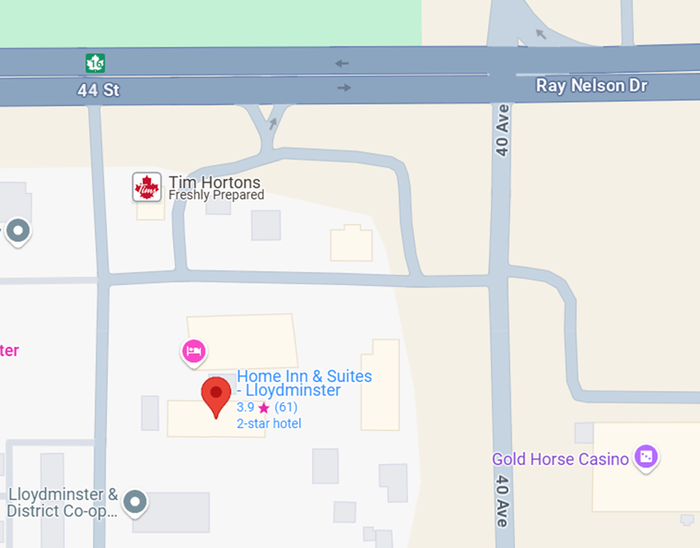
UNION MEETINGS
  Monthly Every second Thursday at 6:00pm
  No meetings in July and August
  Meetings are held in person at the Lloydminster Home Inn & Suites (the east side of the City and online via zoom
  Prize draws and snacks
10

Slide 11
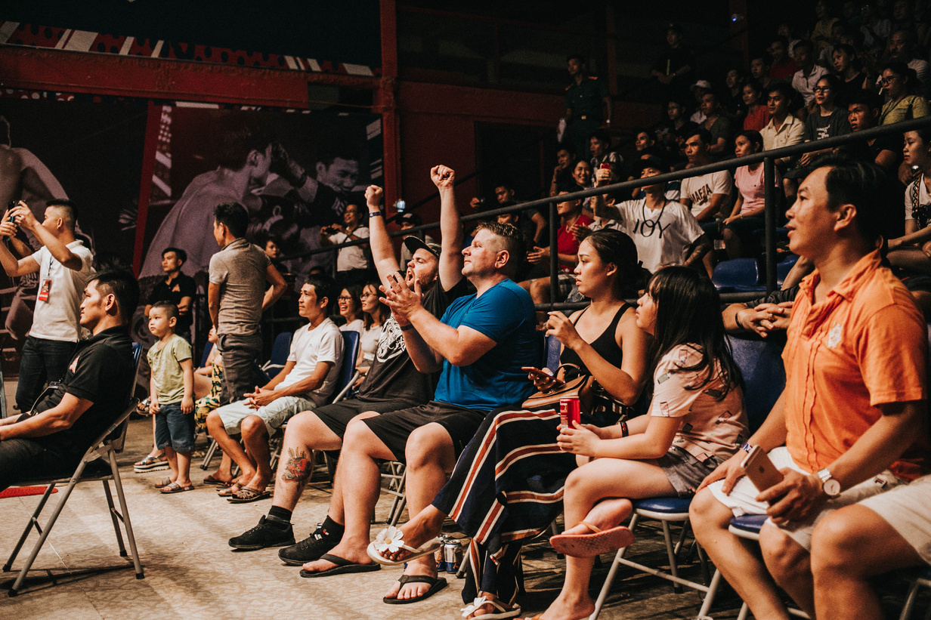

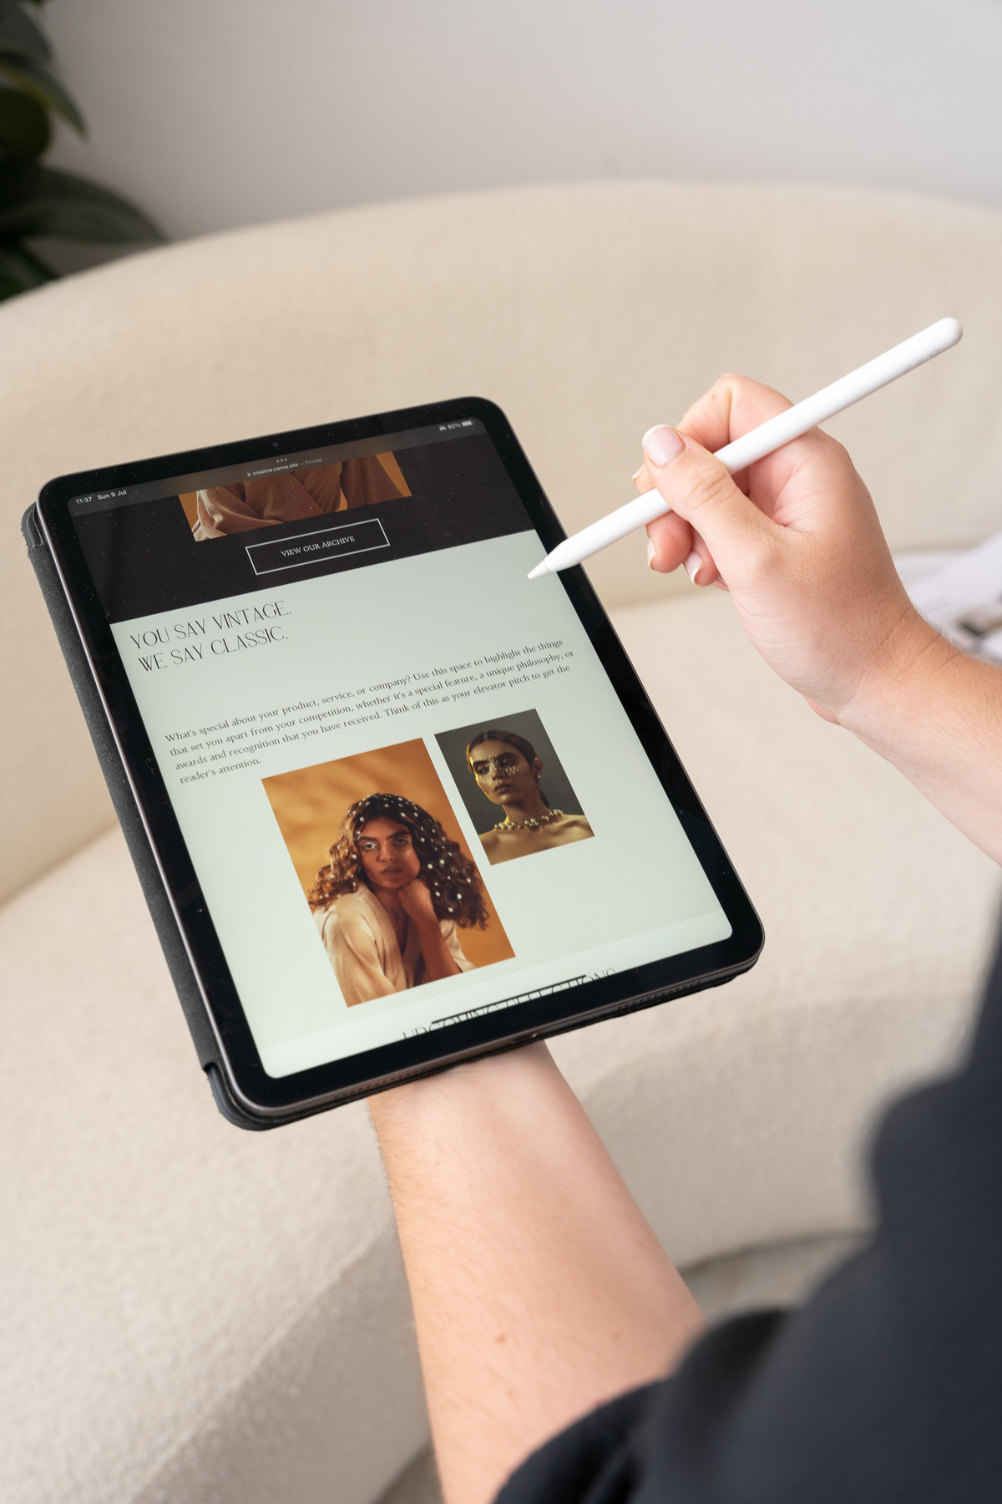
Contacts & Resources
  CUPE 1015 Website: https://1015.cupe.ca/
  Bulletin board
All facilities have a bulletin board for your Local
• Contact list for the executive and stewards
• Union meeting posters
• Job postings
2. Local 1015 email, phone
3. CUPE National website: cupe.ca
4. CUPE Alberta website: alberta.cupe.ca
5. OneCityConnect: My Employment/Cupe1015
Stay connected and updated
11

Slide 12

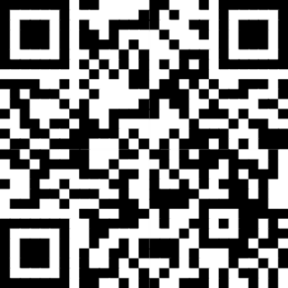
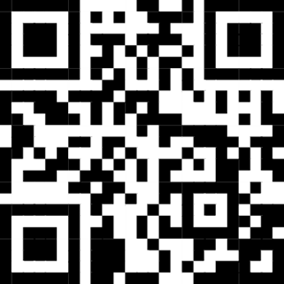
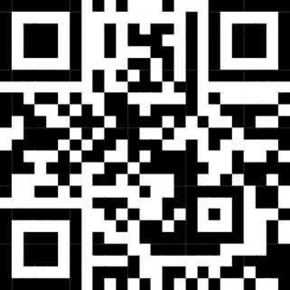
Discounts for CUPE members
CUPE Alberta website for more information, or use the app Endless Savings and More.
Just show your membership card!
•App available on the App Store and Google Play, code is CupeAB
CUPE AB Link
App Store Link
Google Play Link
6
12

Slide 13
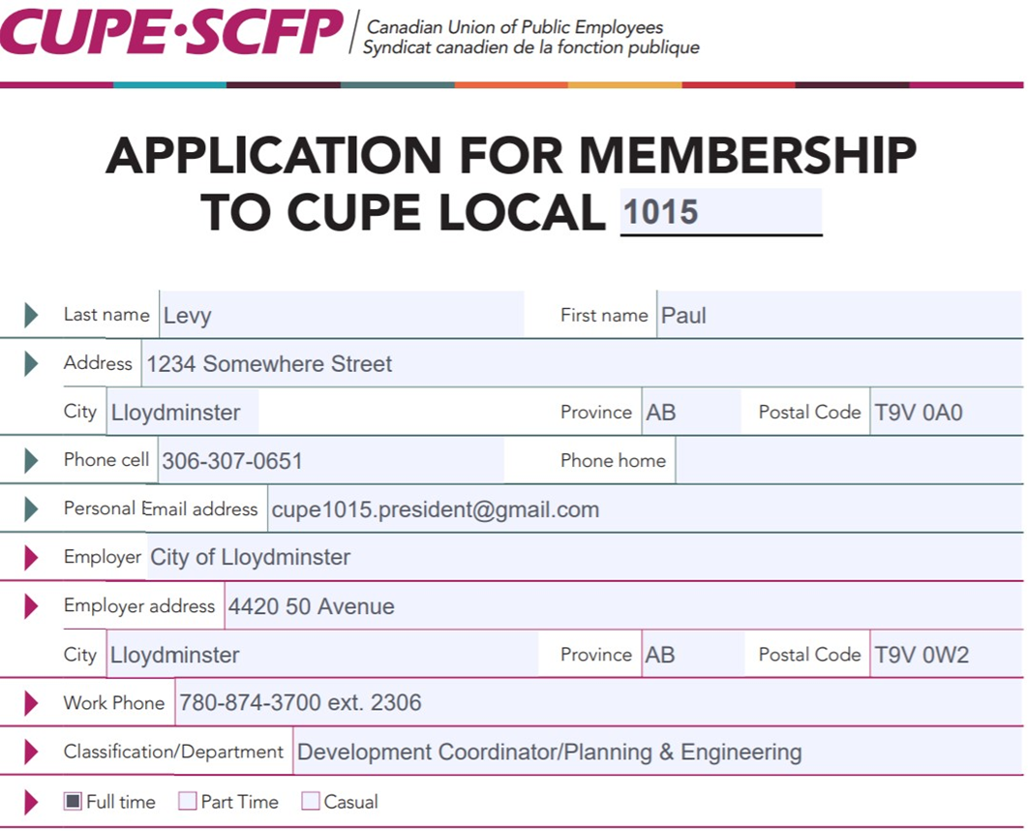
CUPE MEMBERSHIP
  Fill in your own name, home address, phone number, email address
  Employer name and address will be the same for everyone
  Fill in your classification, department, and telephone number
  Only sign the signature line, I will sign the witness section
13

Slide 14
THANK YOU & Q&A
•Questions? We’re here to help.
•Sign up for updates and resources
•Welcome to CUPE Local 1015!

